Slide 1
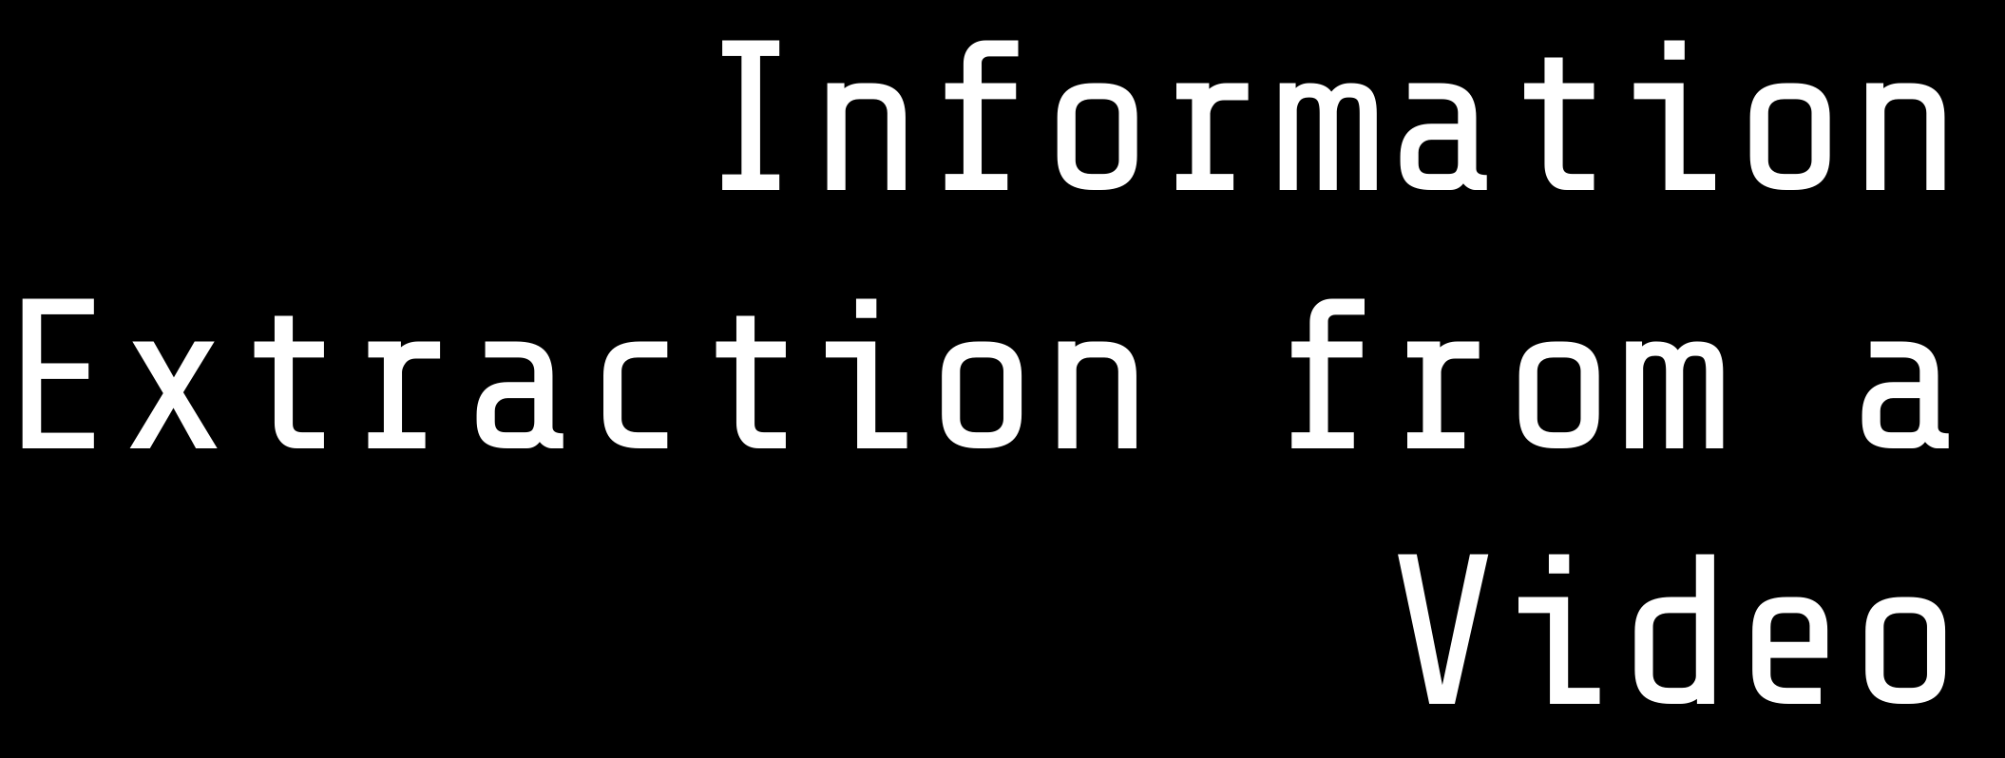






⥫
Using LRCN and UCF50 dataset
Presented By: Abhishek Sokhal - 21U03007 Chitransh Kulshrestha - 21U3024

Slide 2








The primary goal of this project is to develop a model capable of recognizing human actions within video content.
This is achieved by leveraging a combination of CNN and LSTM networks, specifically employing the Long- term Recurrent Convolutional Network (LRCN) approach.
The project utilizes the UCF-50 dataset, a widely recognized benchmark for human action recognition. This dataset contains 50 different action categories, each represented by multiple videos

Slide 3





Human Activity Recognition (HAR)
Long Short-Term Memory (LSTM) Convolutional Neural Networks (CNN)
LSTM-CNN Model Data Preprocessing Model Training
Evaluation Metrics UCF-50 Dataset

Slide 4






Dataset used: UCF50
The UCF-50 dataset
is a comprehensive
collection
of 50
different action categories, each represented by multiple videos.
This dataset is used to train and test the LSTM-CNN model for human activity recognition. The model learns to recognize actions by analyzing the spatial and temporal features extracted from the video frames.

Slide 5





Model Architecture
LRCN Model Overview: The Long-term Recurrent Convolutional Network (LRCN) combines CNN and LSTM layers for spatiotemporal feature extraction, making it suitable for video-based tasks like action recognition.
TimeDistributed Wrapper: Utilizes the TimeDistributed wrapper to apply CNN layers to each frame, enabling the model to process video sequences effectively.
Convolutional Layers: Employs convolutional layers for feature extraction from video frames, capturing spatial patterns that are crucial for action recognition.
LSTM for Temporal Modeling: Incorporates LSTM layers to model the temporal sequence of actions, allowing the model to understand the dynamics and progression of actions over time.
Dense Layer for Classification: Concludes with a dense layer that performs the final classification, predicting the action category based on the extracted features and temporal information.

Slide 6






Model Compilation: The LSTM-CNN model is compiled with the Adam optimizer, categorical cross-entropy as the loss function, and accuracy as the metric.
Early Stopping: An EarlyStopping callback is
used to halt training when the validation loss stops improving, preventing overfitting.
Training Parameters: The model is trained for
50 epochs with a batch size of 8, using 20% of the data for validation.
Data Preparation: The UCF-50 dataset is
preprocessed to extract frames, resize them, and normalize pixel values.

Slide 7







Performance Metrics: The model's performance is evaluated using accuracy and loss metrics on both the training and validation sets.
Visualizations: Training | and | validation loss over | epochs | are
visualized to illustrate | the | learning process.
Challenges and Solutions: Discusses any challenges encountered during training, such as overfitting, and how they were addressed.

Slide 8
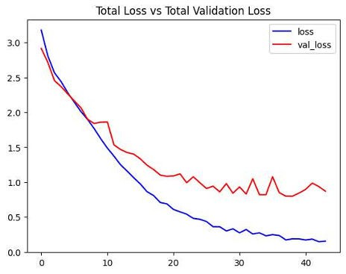
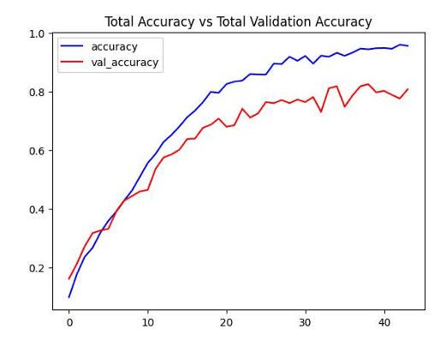
Result Analysis
Model Performance: Final loss - 0.72 Final Accuracy - 82.54
Loss curve
Accuracy curve

Slide 9

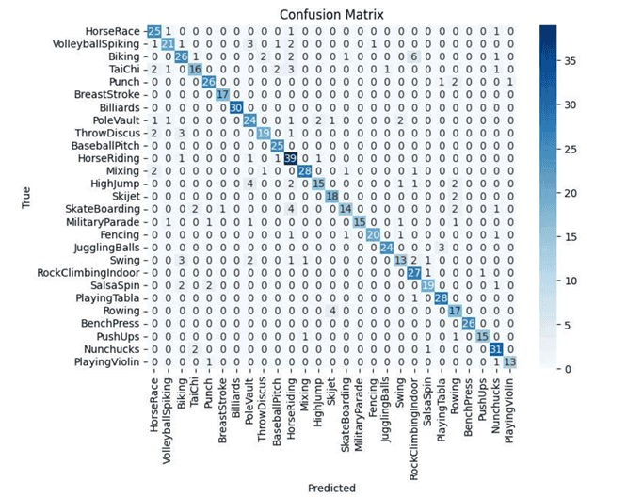
Confusion Matrix and analysis
Loss and accuracy curves demonstrate gradual convergence during training, indicating effective learning. The confusion matrix shows highlighted diagonal values, supporting the high accuracy of the model. The model achieved a relatively high accuracy of 82.54%, indicating that it correctly classified 82% of the test samples. The loss value of 0.72 suggests that the model's predictions have some discrepancy from the true labels, but it's within an acceptable range. Further optimization and fine-tuning could enhance performance and generalization.

Slide 10



Conclusion
In conclusion, leveraging and for multi-level information extraction in video action recognition offers promising avenues for advancing the state-of-the-art in video analysis. The integration of deep learning and temporal modeling holds significant potential for various real-world applications.

Slide 11










Thanks!
Feel free to ask any question?
https://github.com/chitranshk1301/minor-project

